Slide 1


Serverless Application Analytics Framework
Robert Cordingly, Hanfei Yu, Varik Hoang, Zohreh Sadeghi, David Foster, David Perez, Rashad Hatchett, Wes Lloyd
School of Engineering and Technology University of Washington Tacoma Sixth International Workshop on Serverless Computing (WoSC6) 2020
Notes:
Hello, my name is Robert Cordingly and today I will be presenting the Serverless Application Analytics Framework

Slide 2
Motivation
Serverless platforms offer many benefits:
Simple deployment
Automatic scaling
Automatic infrastructure management
Only billed for actual runtime
The unpredictable cost of FaaS:
(Function Runtime) x (Memory Setting) x (Price)
What impacts the runtime of an application?
λ
Notes:
The availability of serverless computing platforms appears to be very appealing to developers. For example, function-as-a-service platforms offer features such as simple application deployment, automatic scaling and management of infrastructure, and simple billing models where developers are only charged for the runtime of their application down to sub-second intervals.
But these benefits and abstractions come with downsides. Because runtime and memory settings are the factors that determine cost, it is key to optimize applications to be fast and use an optimal memory setting. But no matter how much a developer optimizes their application, there are factors that will impact the price that are out of their control. To address this problem we created the Serverless Application Analytics Framework.

Slide 3
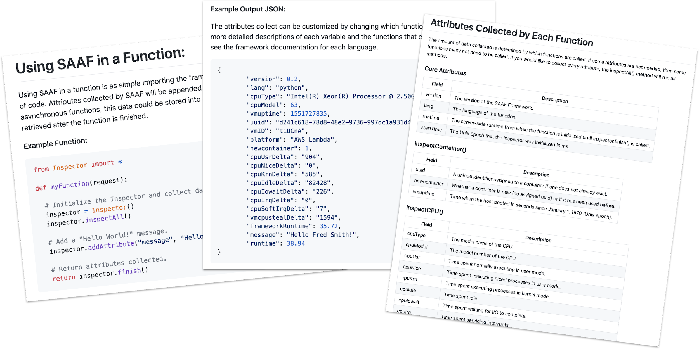
What is SAAF? - The Inspector
Notes:
The serverless application analytics framework, also known as SAAF, provides of a collection of tools for researchers and practitioners to assist research and development of cloud-native applications deployed to function-as-a-service platforms.
The framework is based around the Inspector library. The Inspector library is included in the source code of each function and supports collecting performance and infrastructure metrics. This includes metrics that characterize runtime, CPU and memory utilization, and platform information including the number of FaaS function instances sharing infrastructure, infrastructure state (cold vs. warm), and much more. SAAF is integrated into a function by including the Inspector library, and adding a few lines of code at the start and end of each function being profiled.

Slide 4






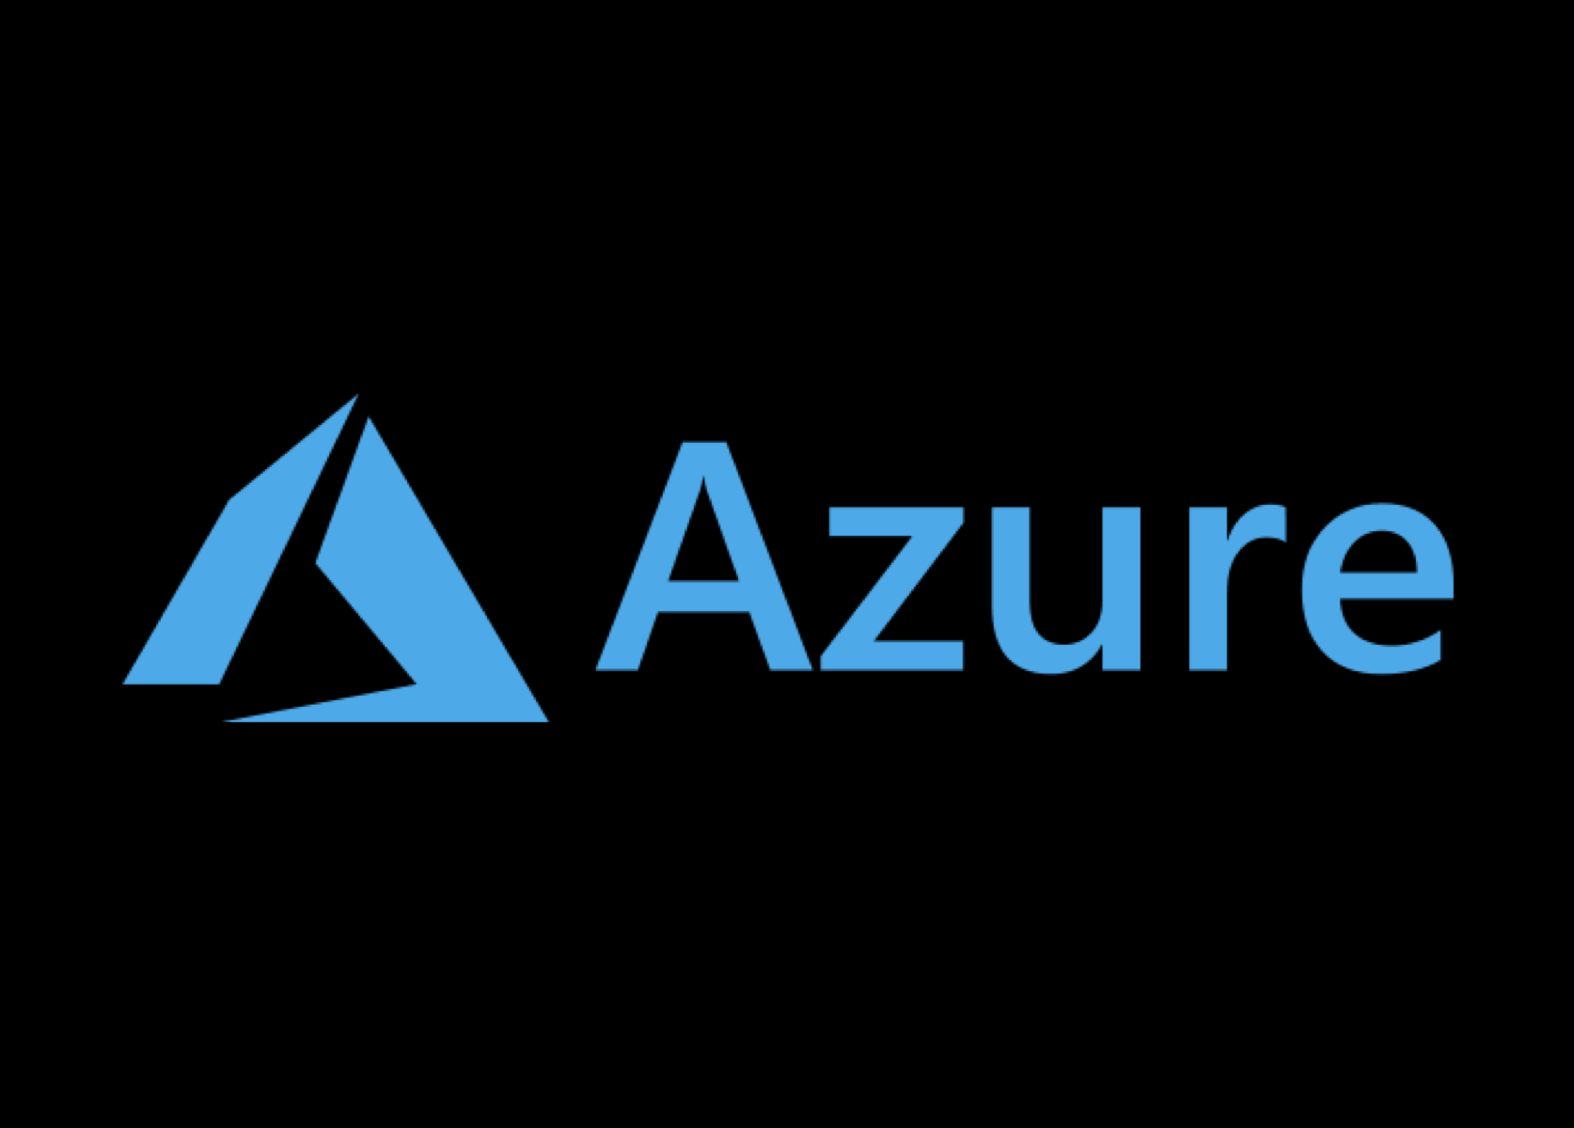


Supported Platforms and Languages
Notes:
SAAF supports profiling performance of functions across many different commercial function-as-a-service platforms, including AWS Lambda, Google Cloud Functions, Azure Cloud Functions, and IBM Cloud Functions.
Presently SAAF offers Inspector libraries available in Java, Python, Node.js, and GO to support profiling FaaS functions written in each of these languages.

Slide 5
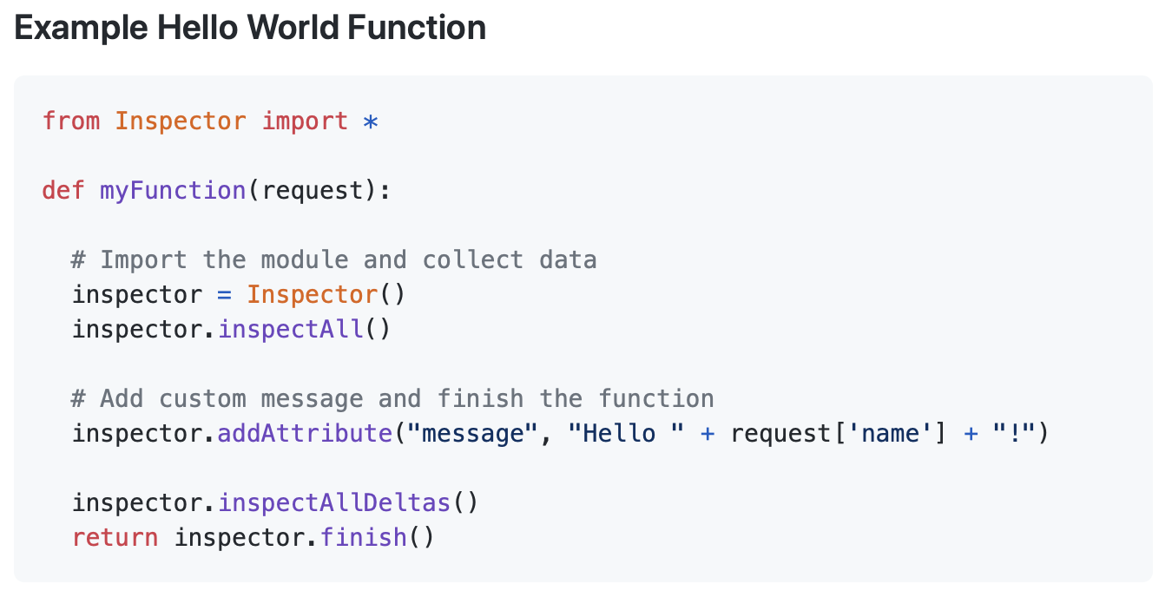
SAAF Tools: Publish Script
./publish.sh
Notes:
To support development and deployment of FaaS applications, SAAF includes multiple helper scripts to automate important tasks.
Most notably, the publish tool automatically packages and deploys functions to FaaS platforms.
For example, Python applications such as the function shown here, can be written and deployed to all supported FaaS platforms without requiring any code changes for each platform.

Slide 6
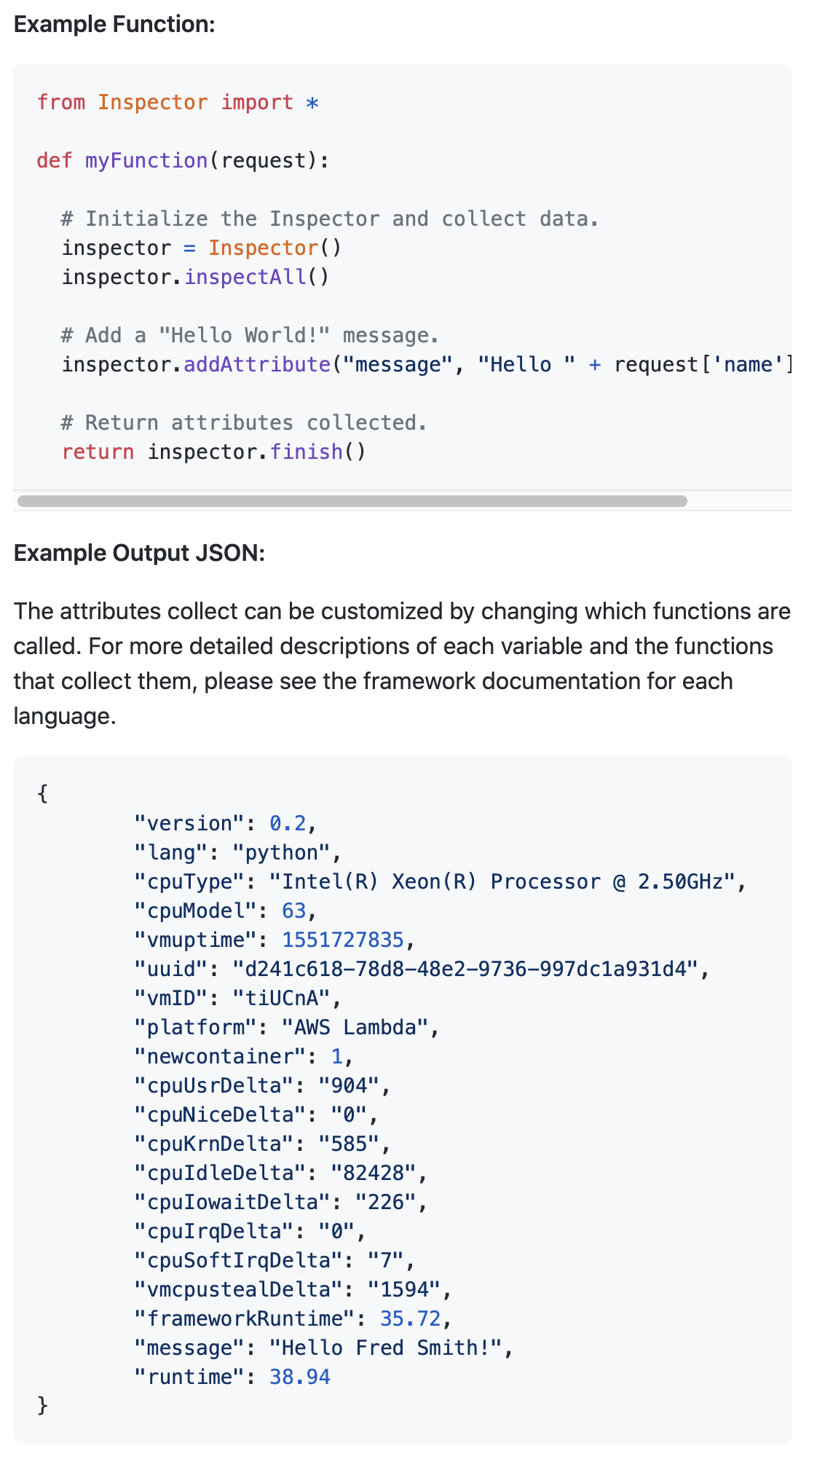




SAAF Metrics and Design
Data collection is directed by calling functions
CPU and Memory metrics are collected from the Linux procfs
Cold/Warm infrastructure state is observed by stamping function instances
Tenancy is determined by introspecting the environment
With another tool we can do more...
Notes:
Developers collect metrics from SAAF by calling functions; such as inspectCPU or inspectMemory. This enables profiling verbosity to be tailored to specific applications to minimize overhead. When a function is finished, SAAF appends its metrics to the JSON payload returned by the function which then can be saved and used for data analysis.
SAAF collects metrics from multiple places inside function instances. CPU and Memory metrics are obtained from the proc filesystem, infrastructure state, lifecycle, and instance reuse is determined by adding a stamp file to the temp directory of a function instance. Finally tenancy, or the number of function instances that concurrently share a host, and FaaS configuration options, are determined by reading environment variables available from the cloud platform.
Even though SAAF is able to extract numerous profiling metrics from the function instance directly, we further extend our observability by introducing a reporting tool to aggregate valuminous data.

Slide 7
SAAF Tools: FaaS Runner
Client for running experiments
Executes reproducible tests defined by files or command line arguments
Automatically change memory settings or redeploy functions
Run functions sequentially or concurrently with many threads
Run functions synchronously or asynchronously
Define payload distribution and creation with inheritance
Execute complex pipelines with multiple functions
Run multiple iterations of an experiment
Automatically compile results into a report
Notes:
The second tool is called FaaS Runner. FaaS Runner is a client application written in Python that is able to generate workloads for experiments on FaaS platforms. By supplying the application with parameters, either through files or command line arguments, FaaS Runner will execute, orchestrate, and compile results for experiments automatically.
FaaS Runner can automatically configure function parameters (such as memory settings), it can execute functions sequentially, in parallel, synchronously, or asynchronously. It can create and distribute sets of payloads to functions, and finally it can even execute complex pipelines of multiple functions. FaaS Runner can be run locally or deployed to a cloud-based virtual machine for improved performance.
Results from experiments are automatically compiled and aggregated into a report.

Slide 8
SAAF + FaaS Runner
Observations made by FaaS Runner:
Network latency
Round trip time
Runtime concurrency
Run/thread IDs to trace pipelines
Sum/average/lists of attributes returned by functions
Combining SAAF and FaaS Runner collects a total of 48 metrics
Notes:
By combining the use of SAAF and our FaaS Runner client we are able to make even more observations. We can calculate network latency and round trip time, we can observe the number of functions running concurrently, we can trace function pipelines, and finally the reports generated by FaaS Runner can aggregate attributes into sums, averages, and lists for quick data analysis after experiments.
Between SAAF and FaaS Runner we can collect a total of 48 different metrics to improve the understanding of performance implications on function-as-a-service platforms.

Slide 9
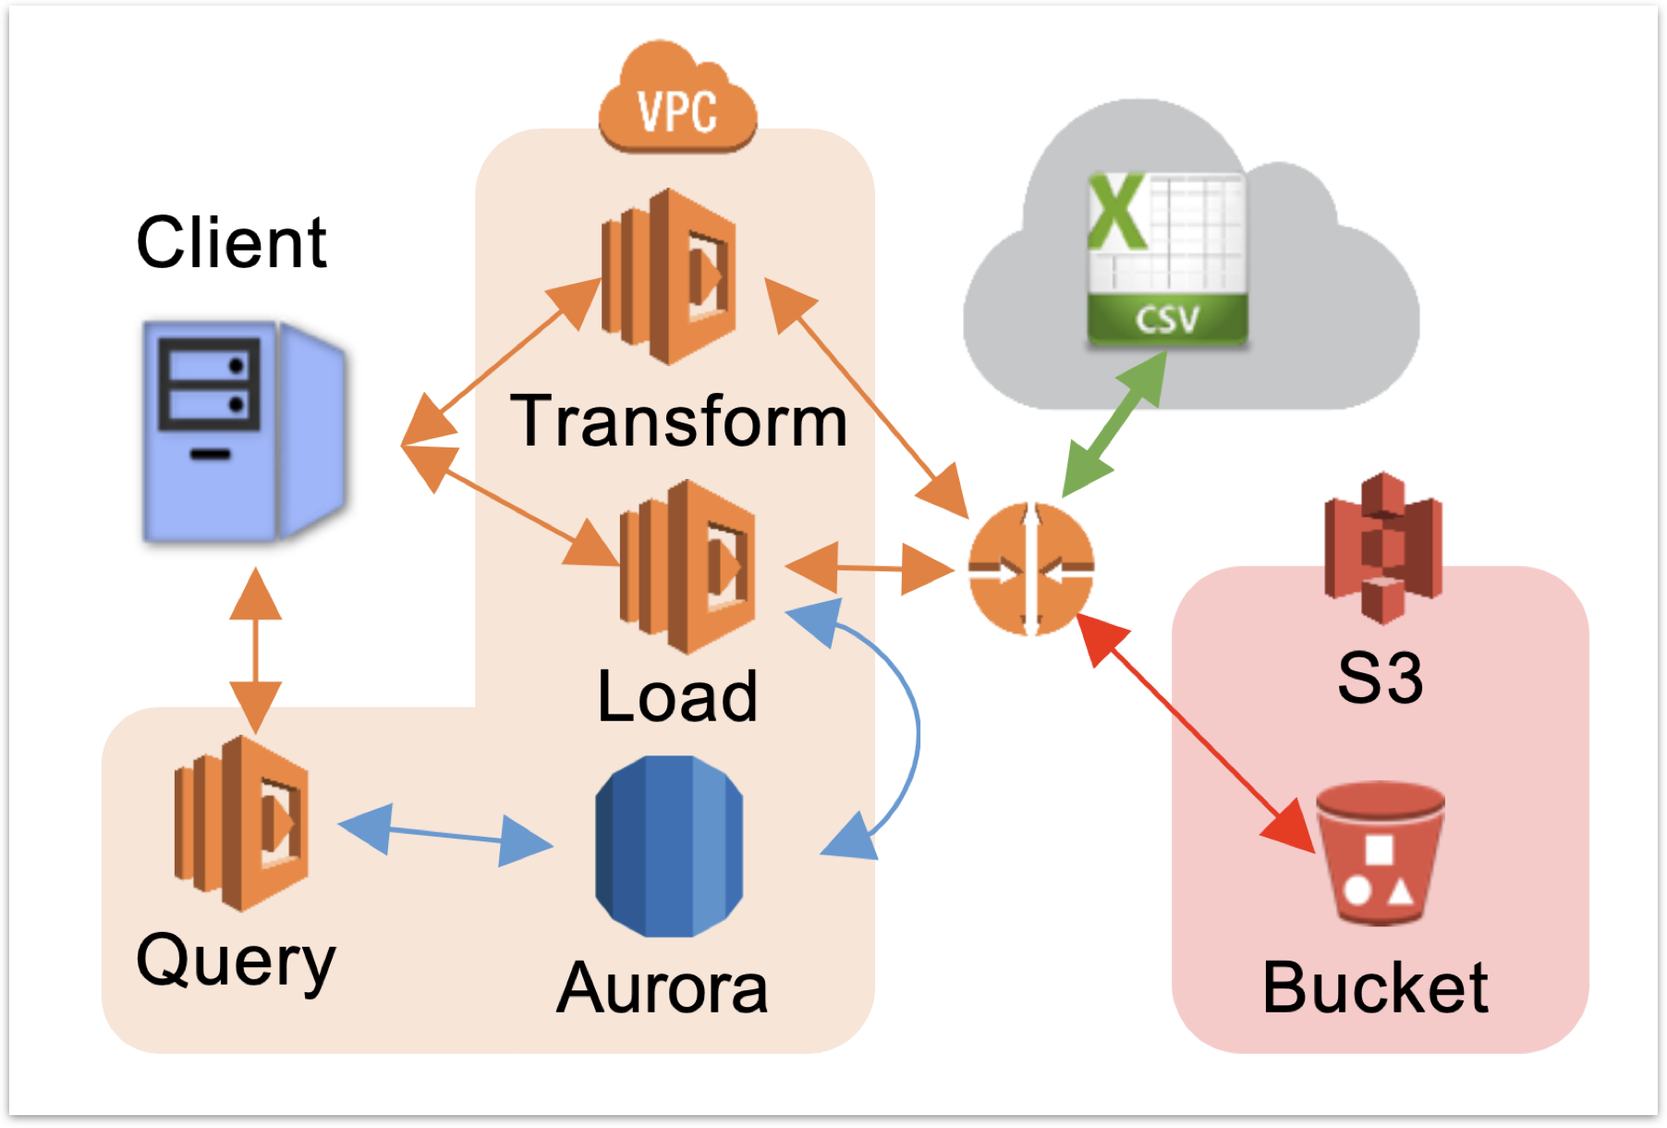
Research with SAAF: Languages Comparison
Notes:
Next I’d like to provide a few examples of research findings we have obtained from using SAAF and FaaS Runner. In the first example, we conducted a performance study of programming languages on FaaS platforms where we developed an identical transform, load, query data processing pipeline in all of SAAFs supported languages: Java, Python, node.JS, and Go.
Using SAAF, we compared the performance, scalability, freeze thaw lifecycle, and performance when scaling function memory for pipeline implementations in each of the languages on AWS Lambda.

Slide 10
Languages Comparison Conclusions
Best Performance: Transform
Low High-Tenancy Impact
Best Performance: Load
Low Cold Latency
Low High-Tenancy Impact
Best Performance: Query
Good Memory Scaling
Good Memory Scaling
Low Cold Latency
Low High-Tenancy Impact
Notes:
We found that no single language offered the best performance in all tests. Java and Go traded places at offering the best performance depending on the function: Transform, Load, or Query.
Go and Python featured the lowest cold start latency.
Java, Go, and Python, all demonstrated little to no performance degradation as the number of concurrent function calls increased.
And finally Java and Python saw higher relative performance as the memory setting of a function decreased.
Because the primary factor of an application’s cost is runtime, we found that implementing this pipeline would cost 94% more if it was implemented in Node.js instead of Java. For optimal performance, a hybrid pipeline where the Transform and Query functions used Go and the Load function used Java offered even better performance than any single language pipeline.

Slide 11
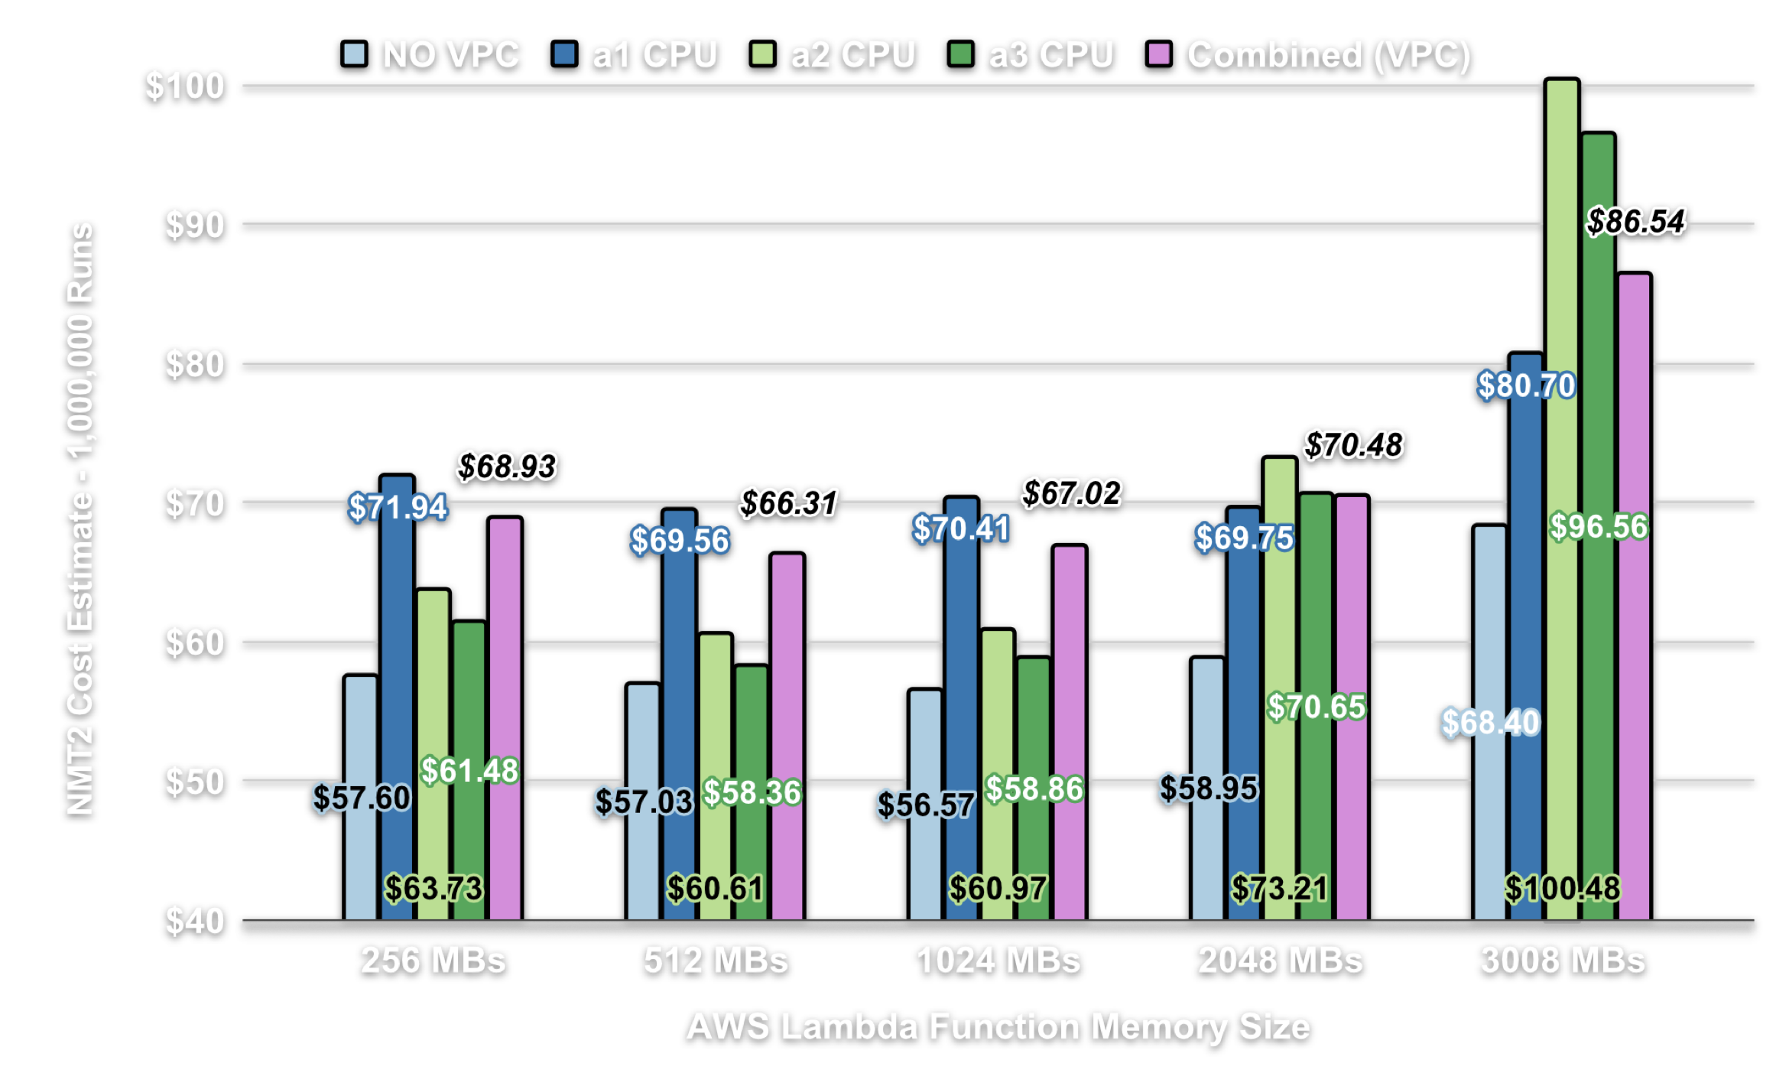
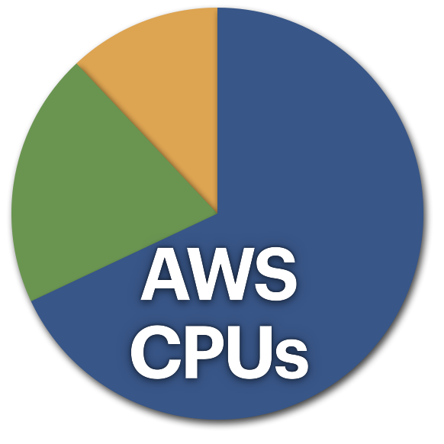
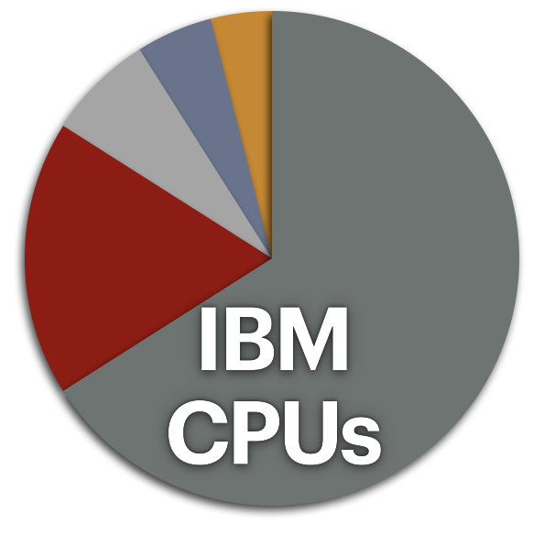
Research with SAAF: Predicting Performance
Notes:
As a second example we have investigated issues of hardware heterogeneity on FaaS platforms.
Many FaaS platforms randomly distribute different hardware to host function instances. In 2019, we found that AWS Lambda used 3 different CPUs and IBM Cloud Functions used 5.
Running the exact same workload across different CPUs has a performance impact. This is another example of price obfuscation on FaaS platforms. Users don’t control which CPU type a function ends up using resulting in inconsistent runtime and cost.
We then built performance models to the predict the runtime of FaaS function workloads that incorporated knowledge of the underlying hardware configurations to improve predictions.

Slide 12
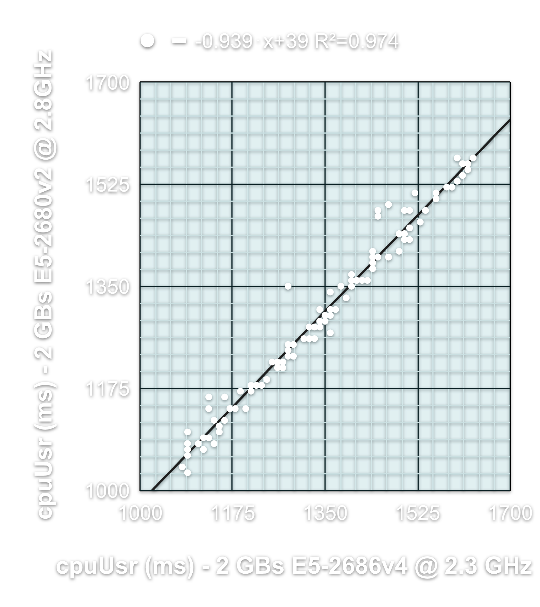
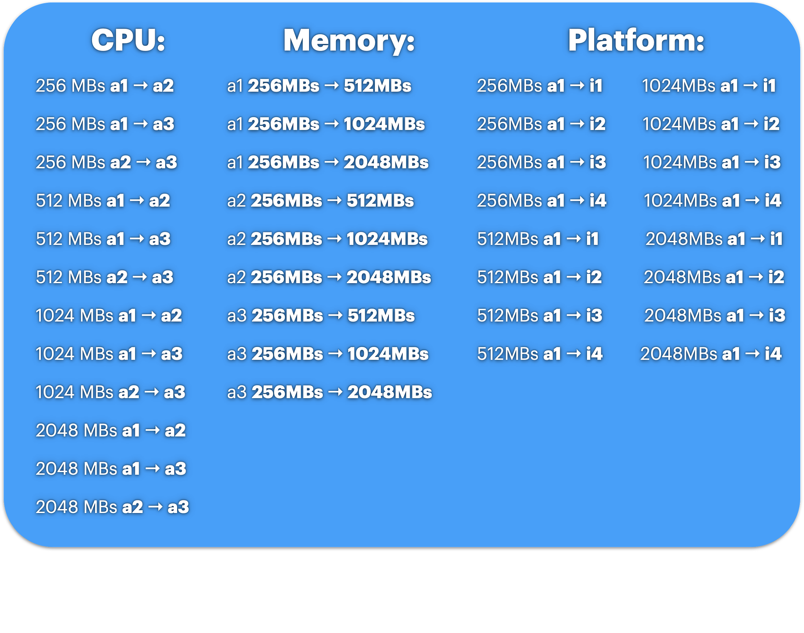
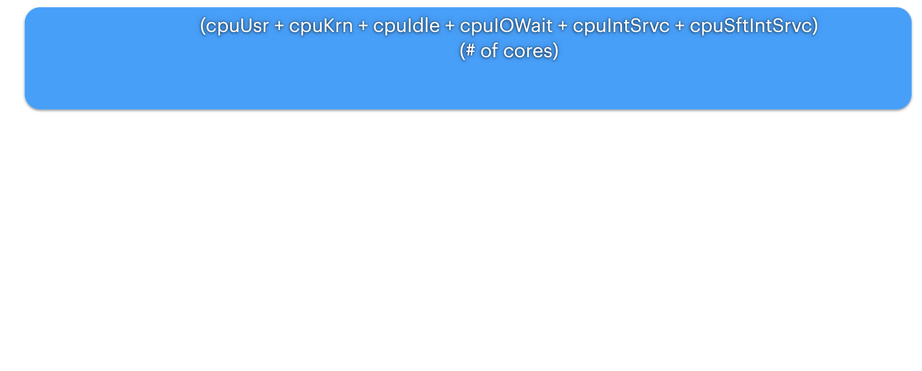
Predicting Performance Scenarios
Prediction Scenarios
Runtime =
Notes:
By using regression modeling and linux CPU time accounting metrics returned by SAAF. We created increasingly complex workloads to test how accurate our predictions could be.
We created models to predict function runtime across 77 differents scenarios and workloads. The major groups in this included predictions across different CPUs, across different memory settings, and the most ambitiously, making predictions of performance on IBM Cloud Functions based on how a function ran on AWS Lambda.

Slide 13
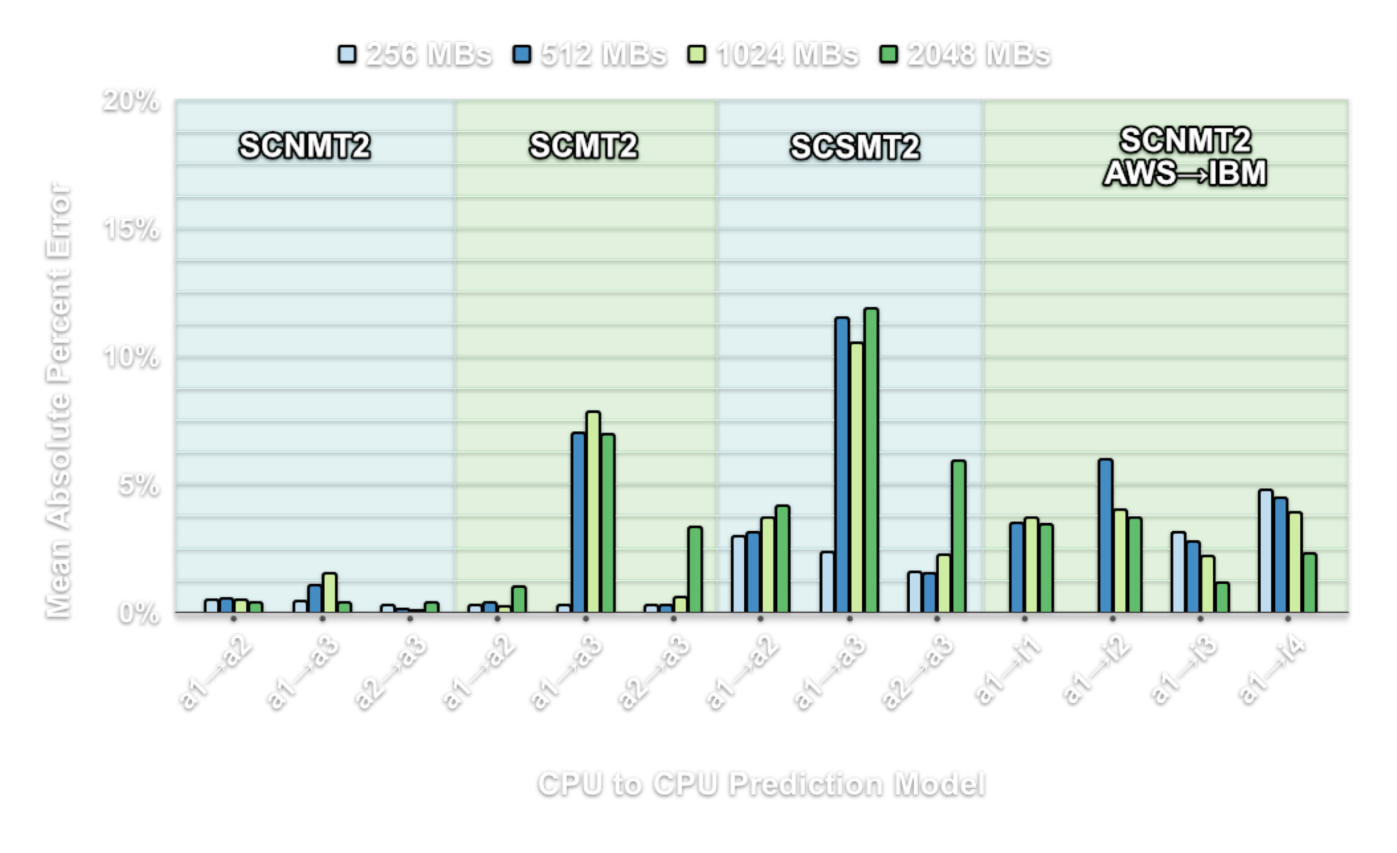

Predicting Performance Conclusions
Notes:
For simple short-lived functions using linear regression was very accurate resulting in less than 1% error for many scenarios. Workloads were then made more complex by adding factors that increased performance variance such as multiple threads and memory page faults. This resulted in increased error for predictions to over 10% corresponding with the increase in workload performance variance.
We found that CPU heterogeneity and multi-tenancy were two key influential factors corresponding with poor performance. We also observed behavioral differences in scaling performance between AWS Lambda and IBM Cloud Functions.
As the memory setting is increased or decreased on AWS, the CPU performance is also adjusted. This is not the case for IBM Cloud Functions, functions are instead let to freely fight for CPU resources. As observed on IBM, memory setting did not directly impact performance for sequential workloads. HERE, a developer should be encouraged to always select the lowest option. Instead, the memory setting served to influence function tenancy - the number of co-resident function executions. It is through co-resident function executions that IBM Cloud Functions performance is constrained. Set the memory reservation higher and you avoid function co-residency. This is not the case on AWS Lambda, where a mid range memory setting may offer the best price to performance. This is another example of FaaS price obfuscation.

Slide 14
Overall Conclusions
SAAF’s goal is to enable developers and researchers to make educated observations into the factors that impact performance on FaaS platforms
Design goals:
Easy to implement and deploy
Low overhead and minimal dependencies
Cross platform/language support
A complete development workflow with SAAF + FaaS Runner:
Development -> Deployment -> Testing -> Data Analysis
Available for anyone
Notes:
Overall, SAAF’s goal is to enable developers and researchers to make informed observations into the factors that impact performance of their applications on FaaS platforms.
SAAF is simple to integrate with new and existing functions. SAAF includes tools to automate function deployment including the FaaS Runner; a powerful tool for automating a variety of FaaS experiments and perform data analysis.
Finally all tools and documentation are open source and available to download on our GitHub.

Slide 15
Thank You!
Questions or comments?
Please email:
rcording@uw.edu or wlloyd@uw.edu
Download the Serverless Application Analytics Framework:
github.com/wlloyduw/saaf Paper Link:
https://www.serverlesscomputing.org/wosc6/#p12
This research is supported by NSF Advanced Cyberinfrastructure Research Program (OAC-1849970), NIH grant R01GM126019, and the AWS Cloud Credits for Research program.
Notes:
Thank you for listening! If you have any questions or comments feel free to ask or email rcording@uw.edu or wlloyd@uw.edu.
If you would like to download and try SAAF, the framework including all of the supporting tools such as the FaaS Runner are available at: github.com/wlloyduw/saaf.

